Slide 1
MARKETING

Slide 2
Marketing Mix (4PS)
Product, Place, Price and Promotions

Slide 3
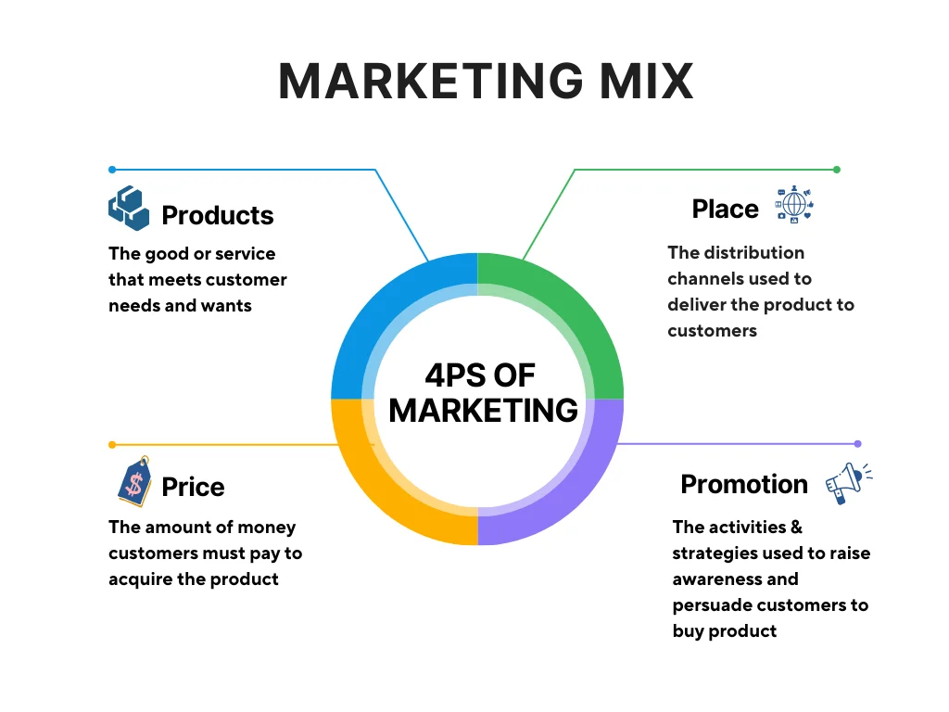

Slide 4
Explanation
Product: Product refers to what the company offers. This is about designing the product or service to meet the needs and wants of the customers. Factors such as the quality, design and packaging of the product must also be considered. In particular, the product life cycle plays a hugely important role in product strategy planning.
Price: Price is the amount a customer has to pay for the product. The company must find the right price to both generate profits and remain competitive. Factors such as discounts, promotions, and payment terms must also be considered in the pricing strategy.
Place: Placement refers to the way the product is made available to the customer. This is about finding the right distribution channel and the right distribution partners to get the product delivered to the customer. Factors such as the availability and presentation of the product at the point of sale must also be taken into account.
Promotion: Promotion refers to the way the company advertises the product or service that is, the communication channels. The aim here is to appeal to the target group and convince them to buy the product. Various advertising media are used.

Slide 5
Product
Features: The product needs unique features and quality that meet customer needs and outperform competitors. Product design should be attractive, recognizable, and suitable for the target audience.
Packaging: Packaging helps in differentiating the product from competitors and in protecting the products accordingly.
Accompanying services: Additional services like warranty, maintenance, and customer care are also important parts of the product.
What is your product?
What does your product do? Does the product meet an unfilled need or provide a novel experience?
Who is your product’s target audience?
What makes your product unique?

Slide 6
Price
Cost-Based Pricing: Setting prices based on the product’s production cost, plus a reasonable profit margin.
Value-Based Pricing: Determining price based on the perceived value of the product to the customer.
Competitive Pricing: Aligning prices with competitors to match or undercut them.
Psychological Pricing: Using pricing tactics to influence customer perception (e.g. Rs.149, Rs.999).
Dynamic Pricing: Adjusting prices based on demand, competition, or other factors.
What is the price range of your product’s competitors?
What is the price range of your target audience?
What price best fits your target market?

Slide 7
Place
Distribution Channel: The paths a product takes to reach customers ,i.e. direct or indirect channels.
Inventory management: Ensuring the right amount of product is available at the right time.
Logistics and transportation: Efficiently moving products from the producer to the consumer.
Physical store location: Selecting optimal locations based on customer demographics and accessibility.
Market coverage: Determining the desired level of market penetration.
Where will you sell your product?
Where does your target audience shop?
What distribution channels are best to reach your target market?

Slide 8
Promotion
Advertising: Paid forms of non-personal communication through various channels (TV ,Billboards ,posters etc.).
Sales Promotions: Short-term incentives to encourage purchase (discounts, coupons, contests).
Direct Marketing: Personalized communication with customers (direct mail, email, telemarketing).
Digital Marketing: Online marketing activities (SEO, social media, influencer marketing, email marketing).

Slide 9
Marketing Strategy
A marketing strategy outlines business goals, target market, buyer personas, competitors, and value for customers. It is the marketing logic by which the company hopes to create customer value and achieve profitable customer relationships. This process involves four steps:
Market segmentation: dividing a market into distinct groups of buyers who have different, needs, characteristics or behavior and who might require separate products or marketing programs. A market segment is a group of consumers who respond in a similar way to a given set of marketing efforts.
Market targeting is the process of evaluating each market segment’s attractiveness and selecting one or more segments to enter.
Positioning is arranging for a product to occupy a clear, distinctive and desirable place relative to competing products in the minds of consumers.
Differentiation is actually differentiating the market offering to create superior customer value.

Slide 10
SWOT ANALYSIS

Slide 11
Let’s do a self-check

Slide 12
SWOT analysis
SWOT analysis is a strategic planning technique that provides assessment tools.
It’s a framework used to evaluate a company's competitive position.
Identifying core strengths, weaknesses, opportunities, and threats leads to fact-based analysis, fresh perspectives, and new ideas.
SWOT analysis assesses internal and external factors, as well as current and future potential.

Slide 13
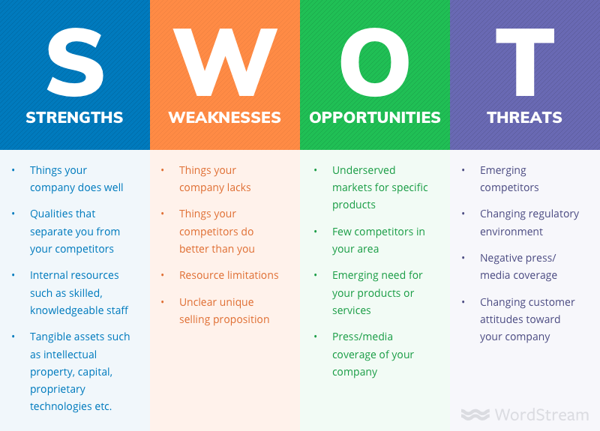
SWOT ANALYSIS

